Slide 1



React vs Angular vs vue.js

Slide 2
React VS Angular VS vue.js
Background :
React
was created by Jordan Walke in 2011 and Open sourced it in May 2013
Facebook and Instagram released React 16.0 on September 2017
The latest version React Fiber was released with React 16 in September 2017. React Fiber is an ongoing implementation of Reac'ts Core Algorithm.
Angular
AngularJS was released in 2010 by Google.
2.0 version which also called Angular 2 or just Angular was
released in September 2016
The latest version Angular 10 released on June 2020
Veu
by ex-Google employee Evan You in 2014
The current stable version is 2.6
Vue 3, currently in the alpha phase, is planning to move to TypeScript.

Slide 3
Comparison:
 | Angular | React | Vue.js
Overview | Developed by Google Large community support | Developed by Facebook Fully supported by Facebook | Standalone Huge team of collaborates (veu.js.org)
Philosophy | Feature-rich one stop shop | Minimalistic package & Focused on UI-building | A framework between angular and react (more like react, but with more features and cli)
Tools | Platform with tools for managing & creating projects (like cli) | Community based packages needed for adding features and code management solutions | Focus on core features for writing a code (router, built-in-state management solution…)
Solutions | Easy to get support - (almost) Everything has a solution | Wide community – solutions probably exist, but has to be searched for | Not everything is built into Vue – e.g. form validation is managed by the community

Slide 4
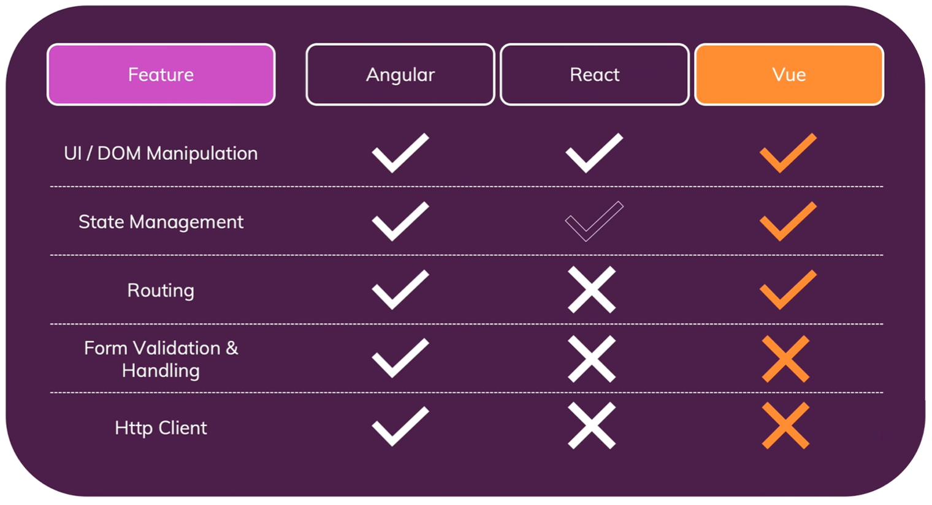
Features:

Slide 5
Comparison: (cont.)
 | Angular | React | Vue.js
Dependency Injection | Provided | No dependency injection | Provided
Writing & Managing Code | Typescript, Templates based on an extended version of HTML Efficient structural framework | Code Stability One-directional data binding Additional independent, fast-moving libraries needed (plus managing updates and migrations) | Can be written in TS,JS, separate html and js pages class-based components
Learning Curve | cli makes it easier (but still complex to use) Typescript – you need to learn separate ts, html | Should learn jsx something new to learn easier than angular Faster Development than angular | Don’t have to use JavaScript not complex setup most of the time Adding import to html file Can use js or ts but not have to separate js html
 |  | Better user experience and very fast performance.

Slide 6
Comparison: (cont.)
 | Angular | React | Vue.js
Evolution | Stable and under dev No one stay behind Seamless updates using Angular CLI | You should check for updates and keep your code updated | Its depend on your uses Features like form validation should be updated manually
Performance | Startup or runtime Bit bigger bundle but not as much Fary start in startup performents Runtime great performance | Fary start in startup performents Runtime great performance | Fary start in startup performents Runtime great performance
MVC Pattern Compliancy | Angular is based on MVC (Model View Controller) , full-fledged MVC framework | React is based on Virtual DOM. You have to solve the M and C on your own
Enterprise Solutions

Slide 7
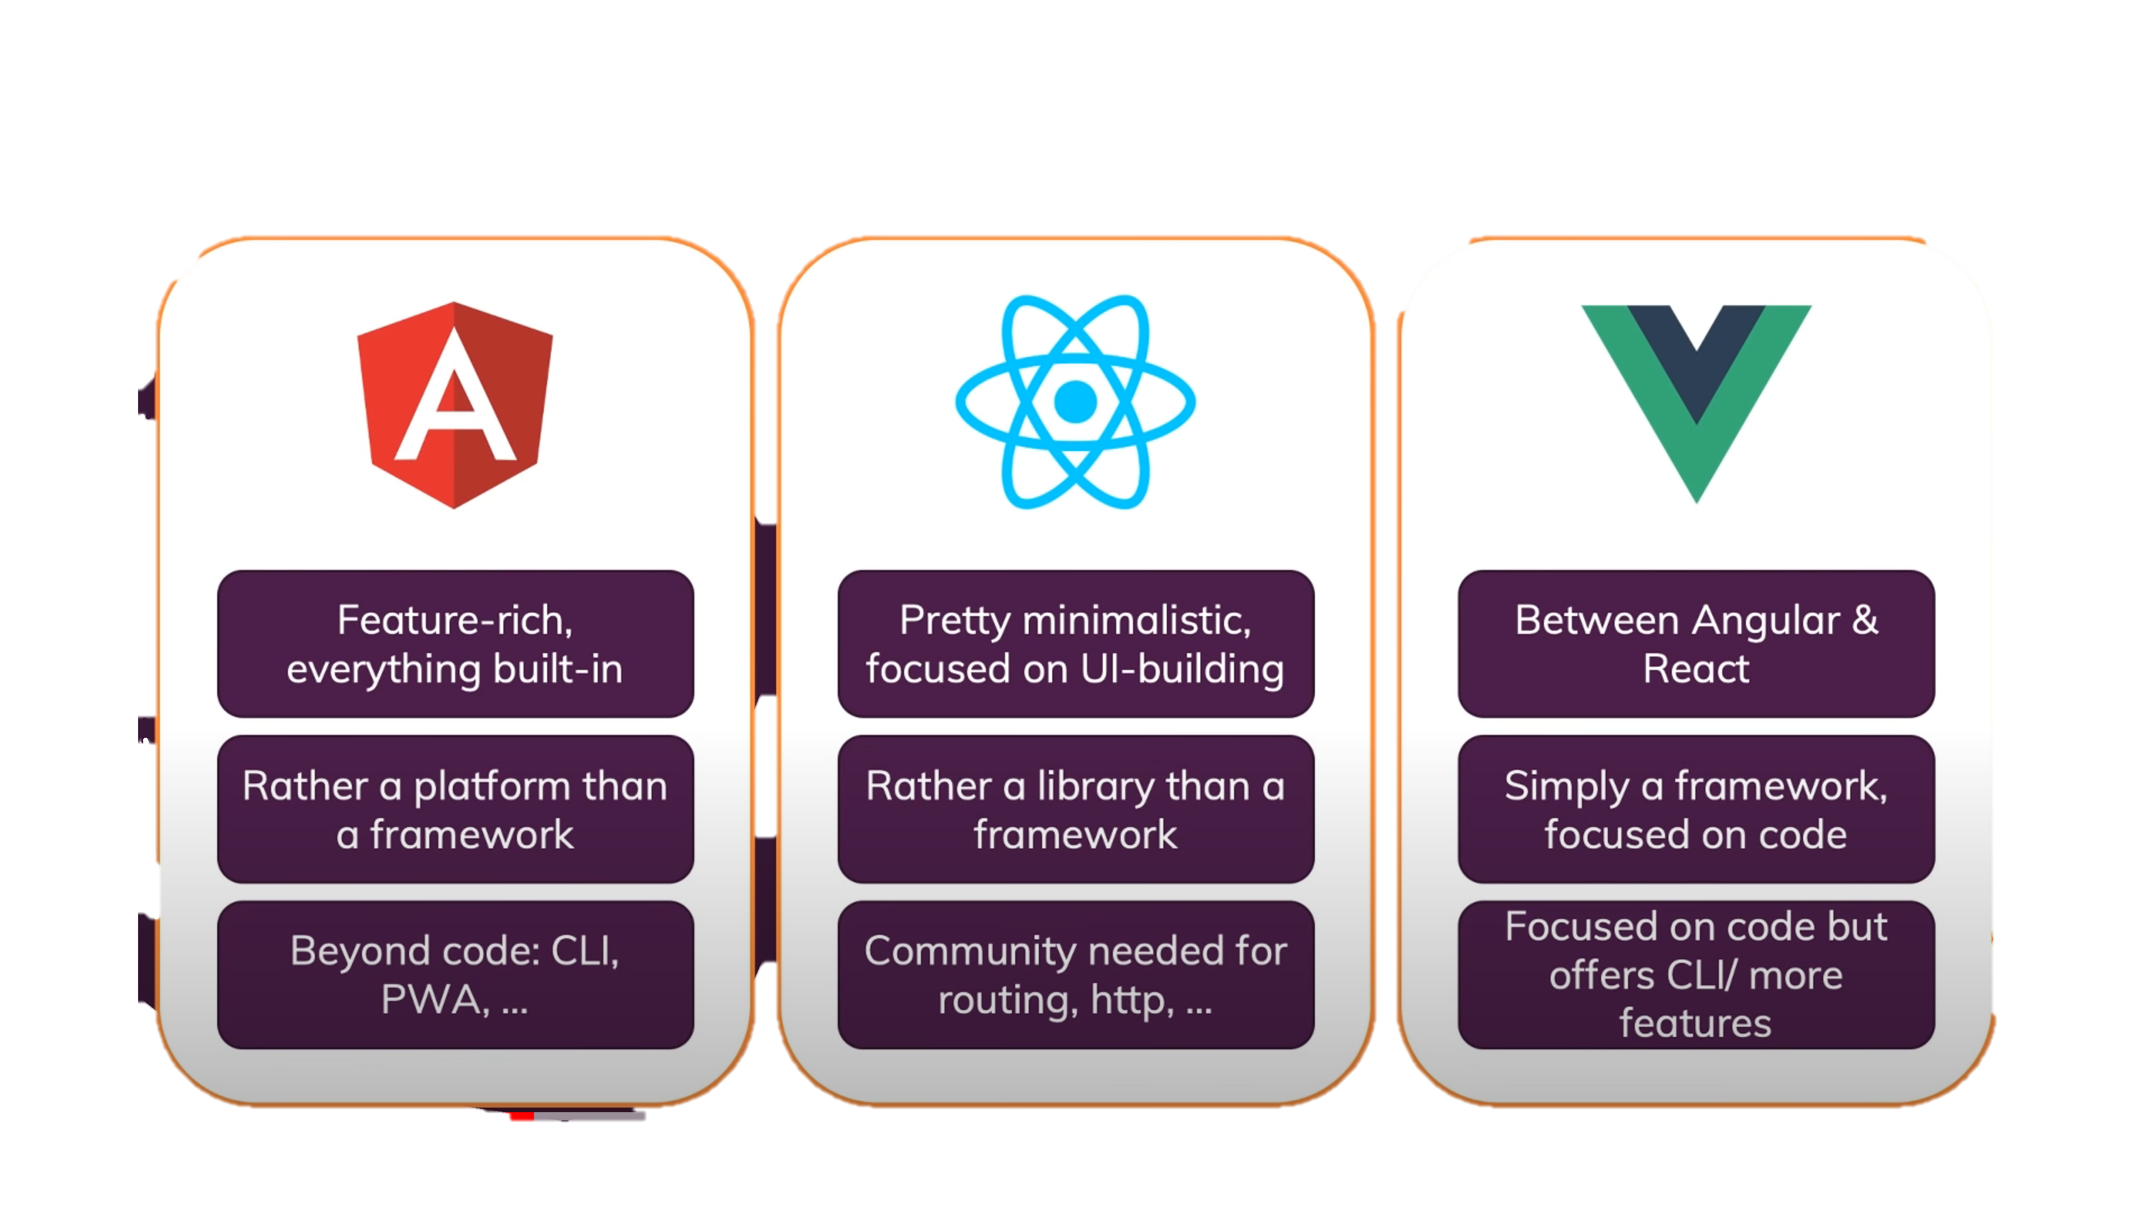
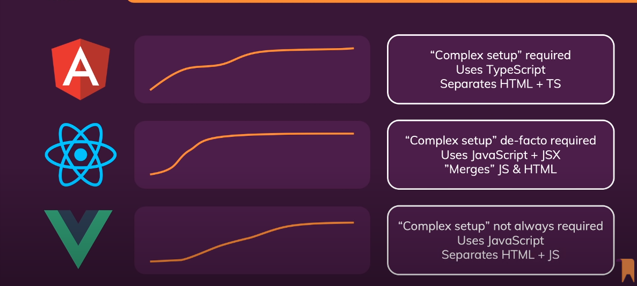
Philosophies
Ease of learning & getting started

Slide 8
Popularity
Depend on where you’re from
React most jobs angular and then veu
React very popular angular and then veu
Alibaba written in veu
Facebook (some parts of its main page) - react
the mobile application on Facebook also builds React Native,
Instegram built completely with React
Netflix also comes under the best React websites list
Yahoo mail using technologies including react react
YouTube it is built using Angular
Netflix
Walmart
PayPal
Gmail

Slide 9
In commune: All of them- frameworks and packages that build user interfaces from reusable component template and logic angular and veu react- js. And jsx a syntax extension to JavaScript. We recommend using it with React to describe what the UI should look like rander in the real dom do i need/want to learn more than one ? Doesn’t hurt to know more than one. Knowing thus 3 is the best, that’s allows to pick the best framework for your application

Slide 10
Angular:
Built-in support for AJAX, HTTP, and Observables
Consistent with technology
Cleaner and crisp Coding
Enhanced support for error handling
Forms and validation
Shadow DOM / local CSS
UI and Business Logic Separation
Modularity,

Slide 11
React:
javaScript library
Allows you to use 3rd party libraries
Time-Saving
Simplicity and Composable
React Component

Slide 12
veu:
Framework
Vue.js 3.0 is being re-written from the ground up for a cleaner and more maintainable architecture
internal functionalities divided to individual packages e.g the observer module will be converted to its own package

Slide 13
References:
Angular vs React vs Vue. – Academind
https://pro.academind.com/
https://programmingwithmosh.com/react/react-vs-angular
https://kruschecompany.com/angular-vs-react-vs-vue-1/
https://clockwise.software/blog/best-angular-applications/

Slide 14
overview- | angular- google Large community support | react- facebook Fully supported by Facebook | veu- standalone, team of collaborates veu.js.org- huge team
philosophies- | * featurs-rich one stop shop, platform has tools like cli for managing and creating projects, easy to get support (almost )everithing has a solution | react- minimalistic and focused on UI-bulding librarty less featurs routers and more managment solutions you need to ise the community manage packages to add this featurs. the community is very wide and active so you probably find the solution -but you have to search it. | veu- between angular and react (more likr react) it is a framework focuse on core featurs that you need for writing a code like- routher, built-in-state management solution. form validation is a feature that manage in the community and not build in to veu Offets cli and more features than react
Dependancy injection | Provide | No dependency injection | Dependancy injection
writing code/ Code management | Written In Typescript, Templates, based on an extended version of HTML offers efficiency Structural framework | Code Stability with One-directional data binding, You will end up using many independent, fast-moving libraries need to take care of the corresponding updates and migrations by yourself
*easy of learning | Cli -make it easier but complex use Typescript –you need to learn separate ts html | Sould learn jsx something new to learn easier than angular Faster Development than angular | Don’t have to use javascript not complex setup most of the time Adding import to html file Can use js or ts but not have to separate js html
popularity 20:00 in youtube Depand on where you’re from React most jobs angular and then veu React very popular angular and then veu |  | Better user experience and very fast performance.
*evolution | Stable and under dev No one stay behind Seamless updates using Angular CLI
*performance | Startup or runtime Bit bigger bundle but not as much Fary start in startup performents Runtime great performence | Fary start in startup performents Runtime great performence | Fary start in startup performents Runtime great performance
Mvc pattern compliancy | Angular is based on MVC (Model View Controller) , full-fledged MVC framework | React is based on Virtual DOM. You have to solve the M and C on your own
Enterprise solusions
Mainstream
BACKUP

